Slide 1

AIML CA3
Haaris bin sulaiman p2112815

Slide 2
Understanding the data

Slide 3
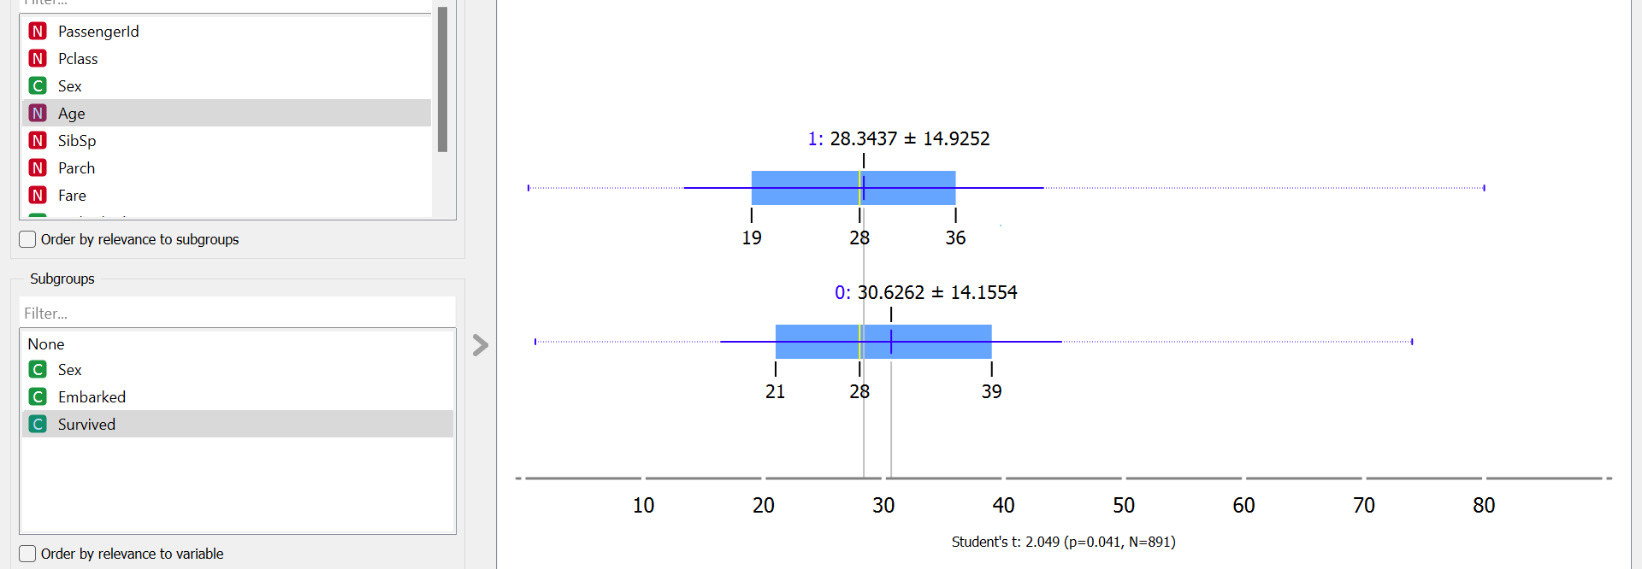
BOX PLOT
I used box plots because they are very good for seeing the range and comparing
I wanted to see the range of ages that survived and did not survive

Slide 4
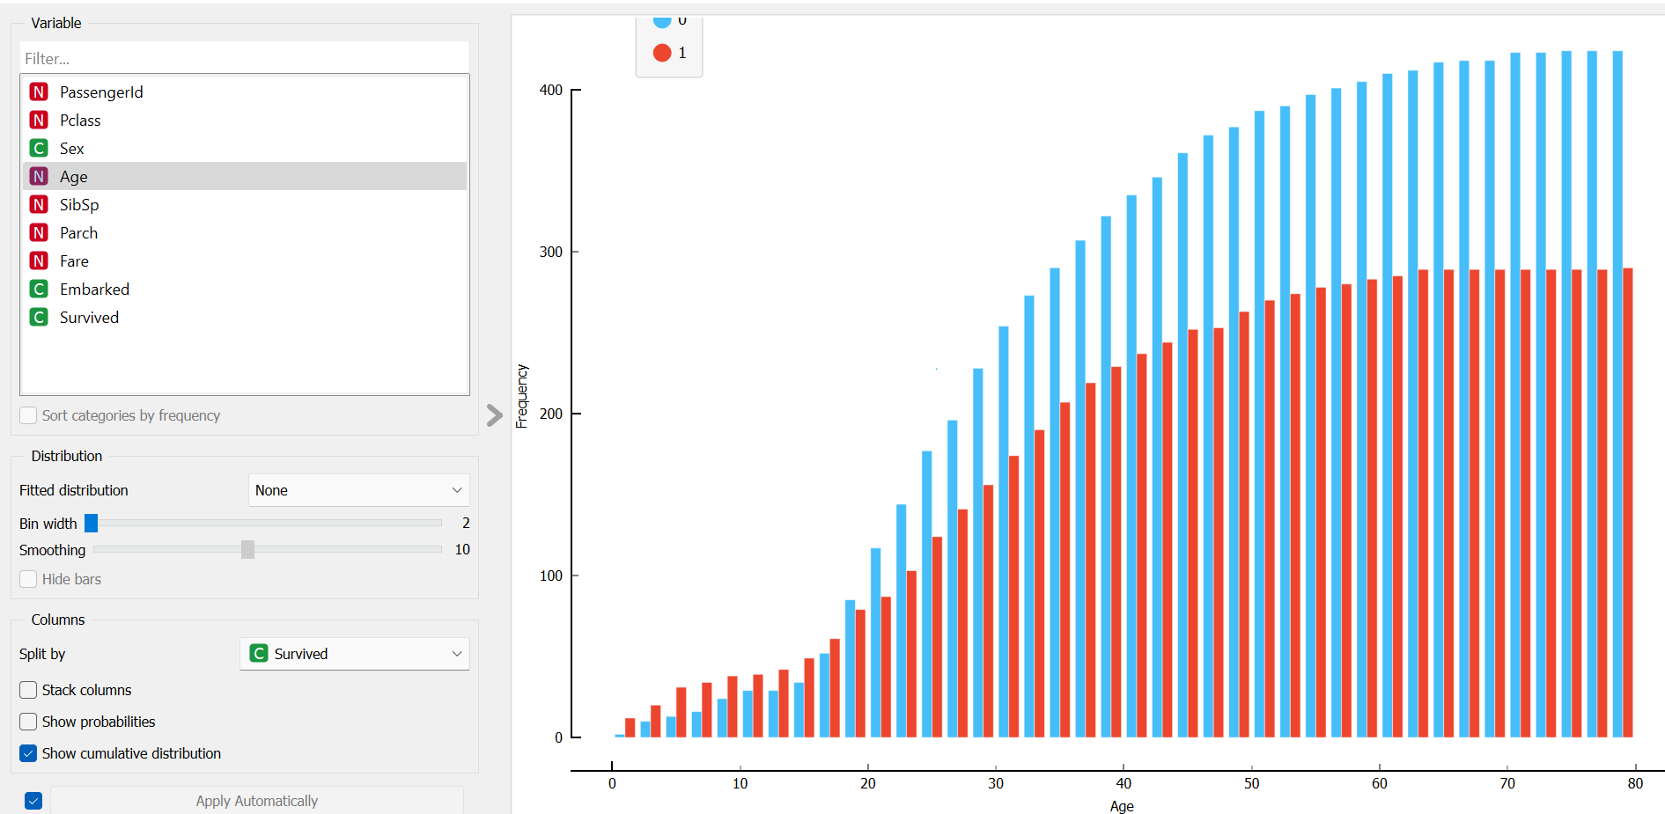
DISTRIBUTION
I used distributions because it is good for seeing the bigger picture and identifying any trends
It is also ideal to identify which variables affect survival of the passengers significantly

Slide 5
SPLITTING DATA

Slide 6
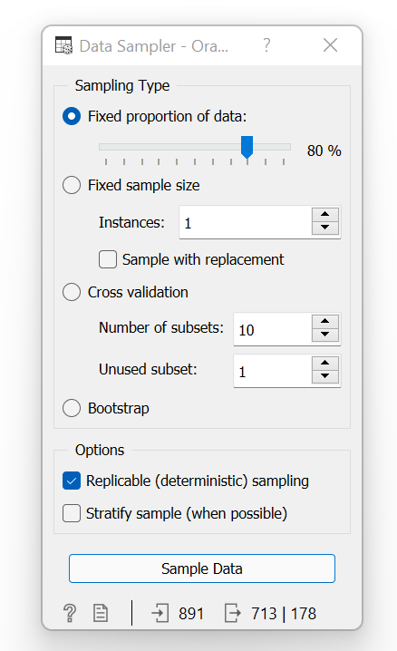
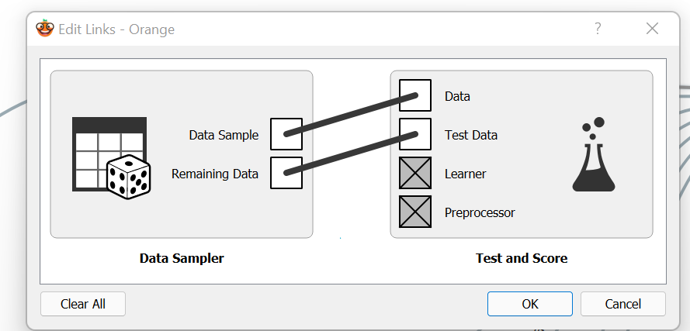
Train and test data
Data is being split into test and train data for the machine learning models using the Data Sampler
As seen below, 713 data points are training data which will be used to build the machine learning model and the remaining 178 data points are test data used to evaluate the machine learning model.

Slide 7
Training models

Slide 8
Different models
I used 5 different models with different precisions to compare the different models
All 5 models have different ways of calculating the probabilities
Thus it makes sense to use more training models to make a more accurate evaluation
The models used are – kNN,Tree,Neural Network,Naïve Bayes and Logistic Regression
The models used are shown in the next slide

Slide 9
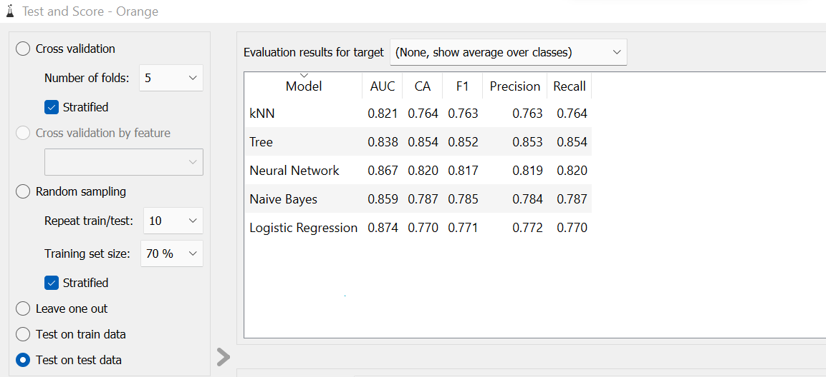

Slide 10
PREDICTION

Slide 11
Which training model to rely on
The tree model has the highest classification accuracy with a value of 0.854
The tree model has the highest precision score of 0.853
The tree model also has the highest recall score of 0.854
Looking at the precision score, recall score and classification accuracy, I will be making my evaluation based on the Tree model.

Slide 12
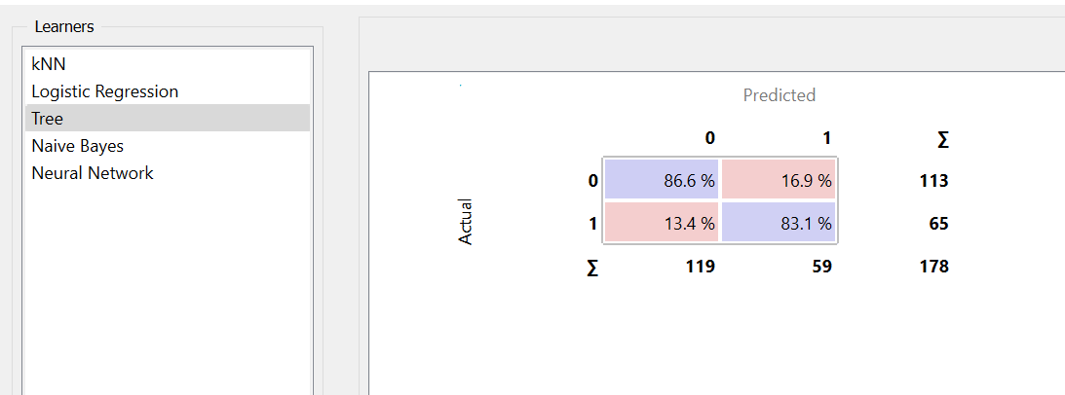
Based on the confusion matrix below of the Tree model, we can see that only 59 out of the 178 people on board are predicted to survive.
This means that only 33.1% of the people on the ship were predicted to survive.
The reality is that 113 people survived. This is almost double the predicted value of 59. The predicted is lower than the actual value and this can be due to many other variables that were not explored and involved in the probability calculations done by the different machine learning training models.
Since there are 713 people on board and given that the probability calculations are based on just 178 people, we can say that the predicted number of passengers should be around 236 people. 33.1% x 713 = 236.
Hence, the predicted number of survivors is 236.

